Slide 1
Employee Data Analysis using Excel
STUDENT NAME: I. FOUZIYA BEGUM
REGISTER NO:2213331042090
DEPARTMENT: commerce
COLLEGE : Bharathi women's college

Slide 2
PROJECT TITLE
Employee Performance Analysis using Excel

Slide 3


AGENDA
Problem Statement
Project Overview
End Users
Our Solution and Proposition
Dataset Description
Modelling Approach
Results and Discussion
Conclusion
3/21/2024 Annual Review

Slide 4

PROBLEM STATEMENT
Our organization is facing challenges in effectively evaluating and improving employee performance. Despite having a performance management system in place, there is a lack of clarity and consistency in the criteria used to assess employee productivity, efficiency, and contribution to organizational goals. Additionally, there is inadequate feedback provided to employees, leading to a decrease in motivation and engagement

Slide 5

PROJECT OVERVIEW
.
An overview of a project focused on improving employee performance would provide a high-level summary of the project's goals, scope, approach, and expected outcomes. Here's a sample project overview for an employee performance improvement initiative:

Slide 6

WHO ARE THE END USERS?
The end users in an employee performance management project are the individuals and groups within the organization who will directly use or be affected by the performance management system. Here are the key end users:
Team Members: The performance system affects how team members collaborate, share responsibilities, and are recognized for their contributions

Slide 7

OUR SOLUTION AND ITS VALUE PROPOSITION
Enhanced Performance Evaluation System:Solution Description: Develop a more robust and transparent performance evaluation system that includes clear, objective criteria, regular performance reviews, and multi-source feedback (e.g., 360-degree feedback from peers, subordinates, and supervisor

Slide 8
Dataset Description
Employee Information:Employee ID: A unique identifier for each employee.
Name: The full name of the employee (may be anonymized for privacy).Department: The department or team the employee belongs to (e.g., Sales, IT, Marketing).Job Title: The official title or role of the employee (e.g., Software Engineer, Sales Manager).Date of Hire: The date the employee joined the organization.

Slide 9

THE "WOW" IN OUR SOLUTION
Wow Factor: Tailor development plans for each employee using advanced analytics and AI to identify their unique strengths, skill gaps, and career aspirations. This personalized approach ensures that every employee has a clear, customized path for growth and development within the organization.Value Proposition: Employees feel valued and motivated when their individual needs
3/21/2024 Annual Review
9

Slide 10
MODELLING
Modeling in the context of employee performance involves creating statistical, machine learning, or computational models to analyze employee data and predict outcomes, identify patterns, and inform decision-making processes. Here’s a step-by-step guide on how you might approach modeling employee performance
10

Slide 11
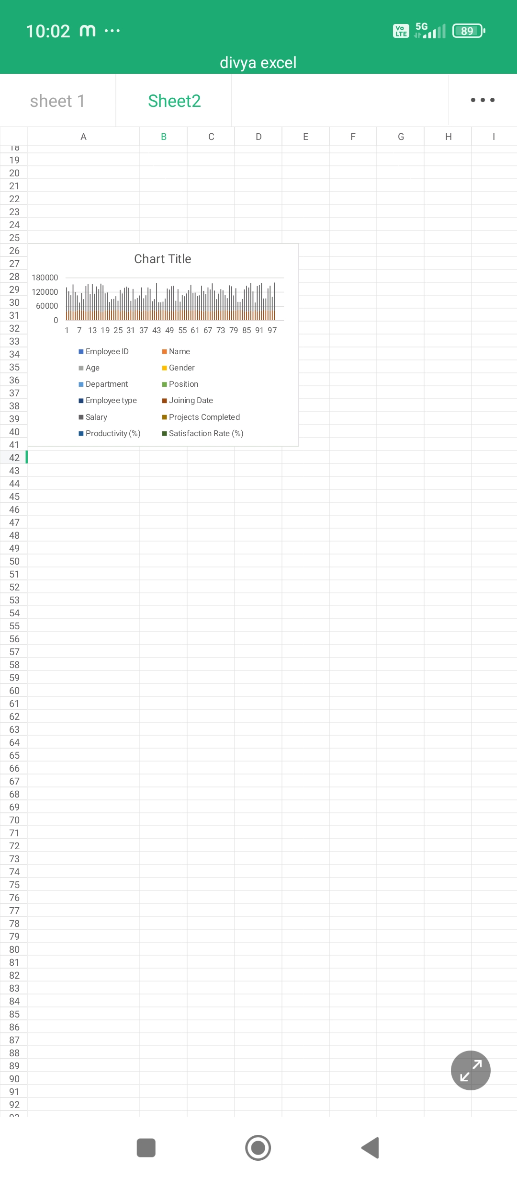
RESULTS
11

Slide 12
conclusion
The analysis and modeling of employee performance provide a powerful framework for enhancing organizational effectiveness and employee development. By leveraging data-driven insights, organizations can make more informed decisions that not only improve individual performance but also align with broader business objectives.Key findings from the employee performance models highlight the critical factors that contribute to high performance and areas where improvement is needed

